Slide 1
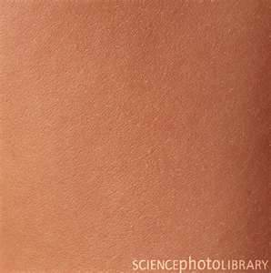
Integumentary System
The skin and membranes

Slide 2
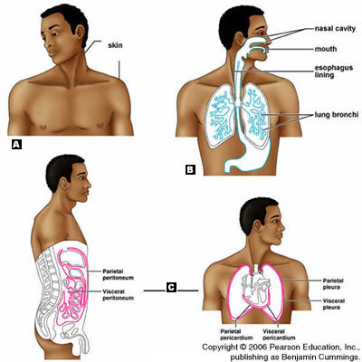
Body Membranes
Epithelial Membranes
Cutaneous
Mucous
Serous

Slide 3
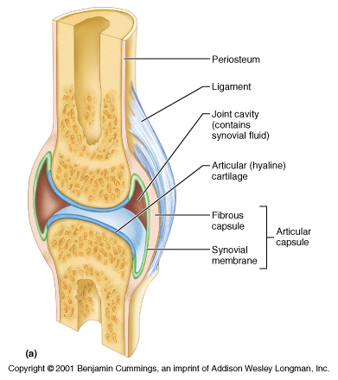
Body Membranes
Connective
Synovial

Slide 4
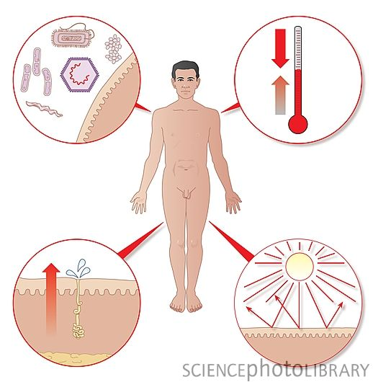
Functions of the Skin
Protect
Excrete wastes
Regulate Body temp.
Make Vit. D and protect against UV

Slide 5
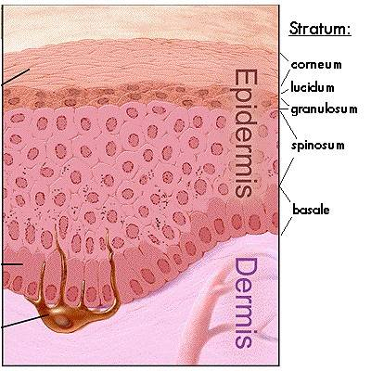
Parts of the Skin
Epidermis
Corneum –top
layer, dead.
Lucindum – keratin
only in feet and hands
Granulosum –
Middle layer
Spinosum – keratin
Basale – bottom
Cell division

Slide 6
Proteins and Pigments of Epidermis
Collagen – protein fibers, strengthen skin
Keratin – waterproofs skin
Melanin – pigment, blocking UV rays
Carotene - pigment

Slide 7
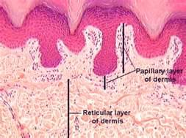
Parts of the Skin
Dermis
Papillary layer
Provide nutrients and
Sensation for epidermis
Reticular layer
Glands
Pressure receptors
Phagocytes

Slide 8
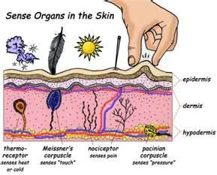
Receptors of the Dermis
Free Nerve endings - pain
Krause’s end bulbs – temp.
Meissner’s Corpuscles - touch
Pacinian Corpuscles - pressure

